Slide 1
CSE-101
Working Principal of Computer

Slide 2
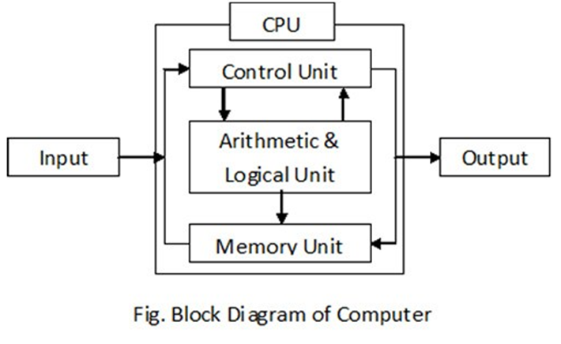
What is Computer?

Slide 3
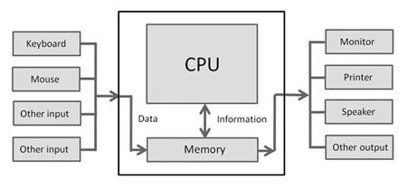
Input and Output are data

Slide 4
CPU
The processor, or CPU, is the part that does processing. The CPU can be said to manipulate data:
Encryption and Decryption (This makes your data secure.)
Math
Logic

Slide 5
Memory (RAM)
The memory gives your computer a place to store information that it might need in order to process data well. The processor can be told to use the memory by specifying it as the input or output. Some things that might be stored in memory might be:
Photos from a Camera (A camera is an input)
A Program
A Text Document

Slide 6
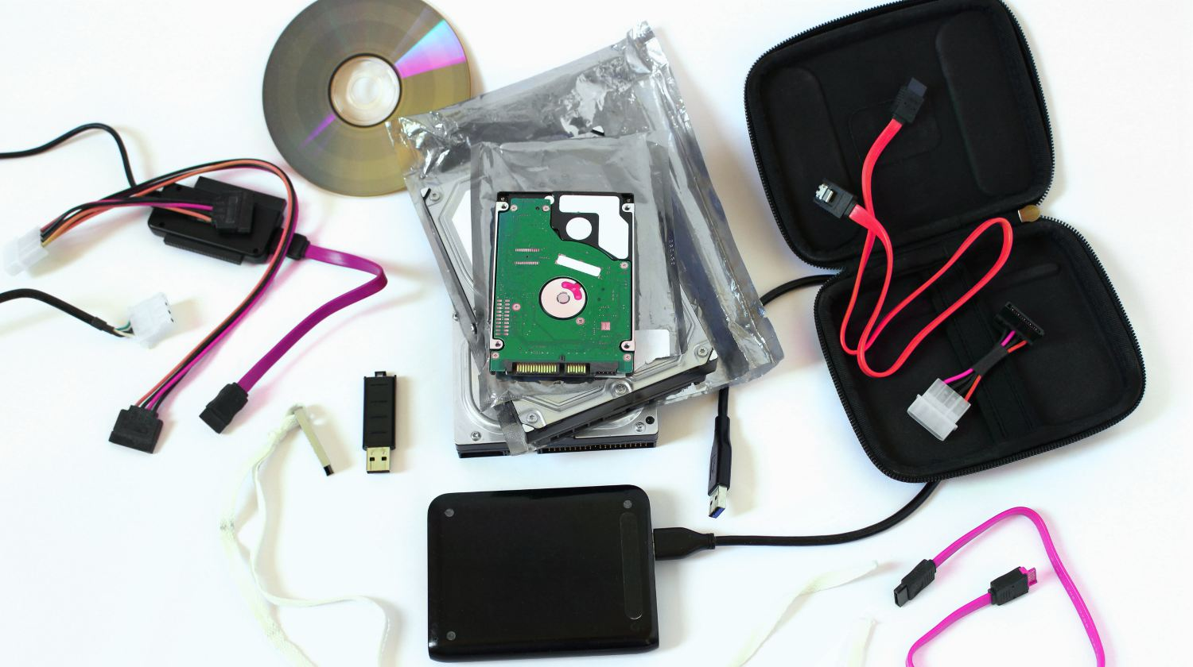
External Storage
The memory gives your computer a place to store information that it might need in order to process data well. The processor can be told to use the memory by specifying it as the input or output. Some things that might be stored in memory might be:
Photos from a Camera (A camera is an input)
A Program
A Text Document

Slide 7
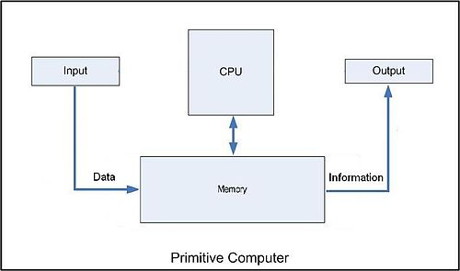

Slide 8
What happens when a program is clicked?
It is loaded to Memory from External Storage
CPU performs operation or process data
Shows the output (probably in screen)

Slide 9
A computer Based System
A computer-based system is a system in which a computer is involved and consists of three major elements: Hardware, Software, and User. The elements of a computer based system are described in the three following scenarios:
Registration in a University A Program
Hardware = Micro computers, Network platform, and a Server Computer
Software = Student Registration Application, Database, and Operating System
User = Operators, Administrators
Playing a game with a Computer
Hardware = Game console such as Xbox, Playstation
Software = The game itself
User = The game player

